Slide 1
A Parent’s Guide to
the Mobile App
Part of Satchel One

Slide 2
Show My Homework can...
Give total visibility of homework!
Send you reminders about upcoming deadlines
Keep you up to date with to-do lists, comments and grades
Give you all the detail you need to support your child’s home learning
Remove the confusion - see what they need to do and when they need to do it!

Slide 3
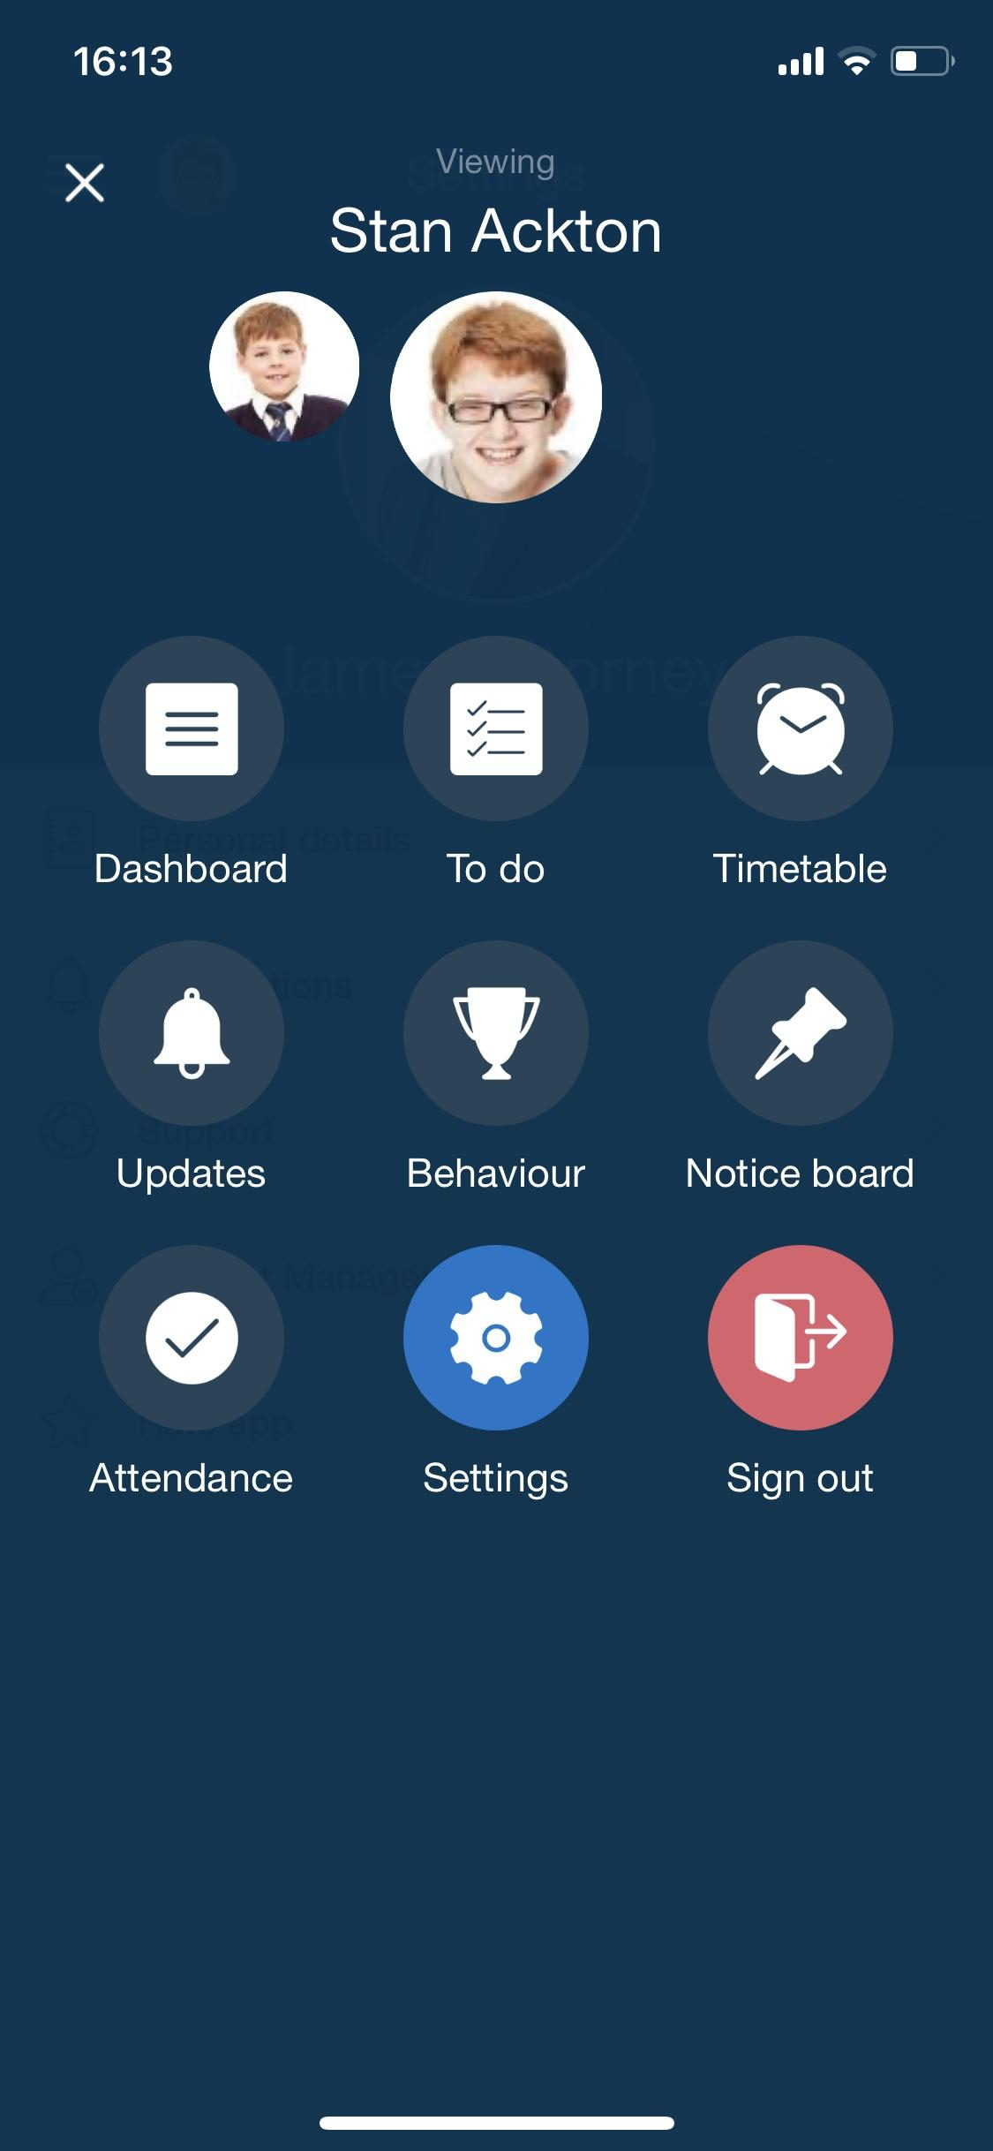
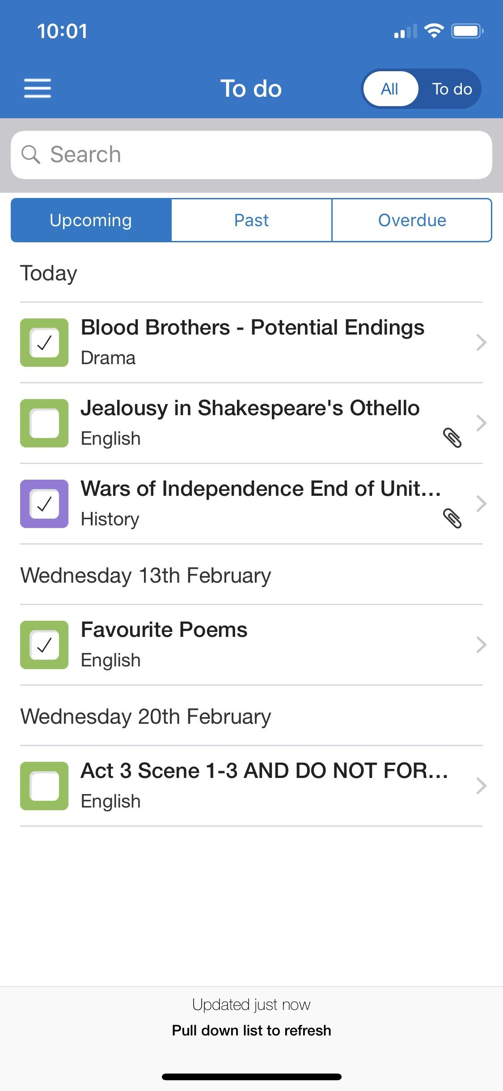
Download our free app!
More than one child? No problem!
See all of their information in one place
Keep an eye on their personal to-do lists
Auto-alerts when homework is given and due

Slide 4
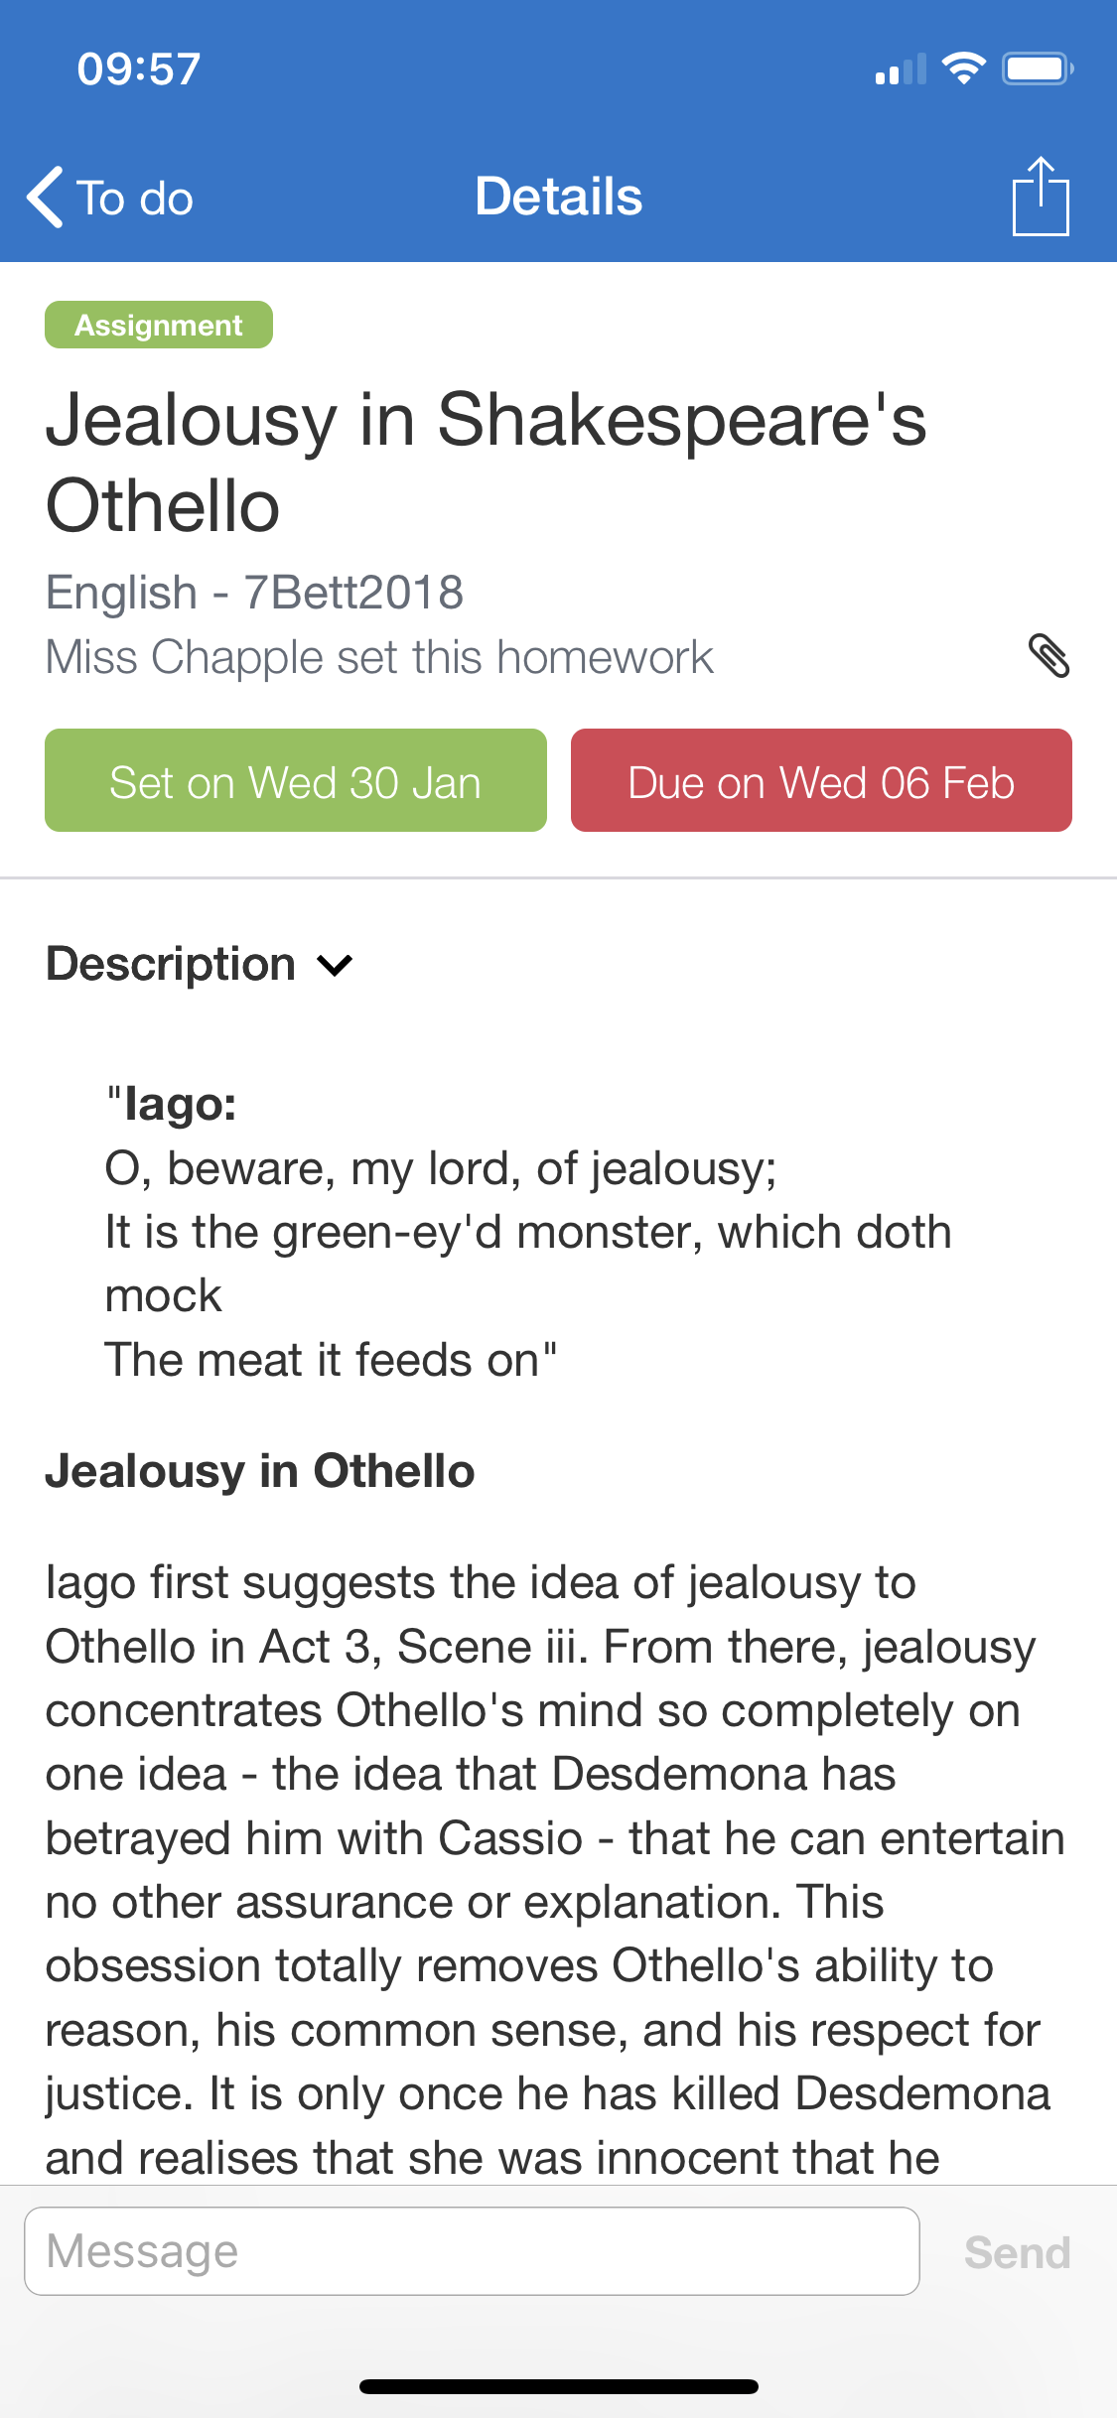
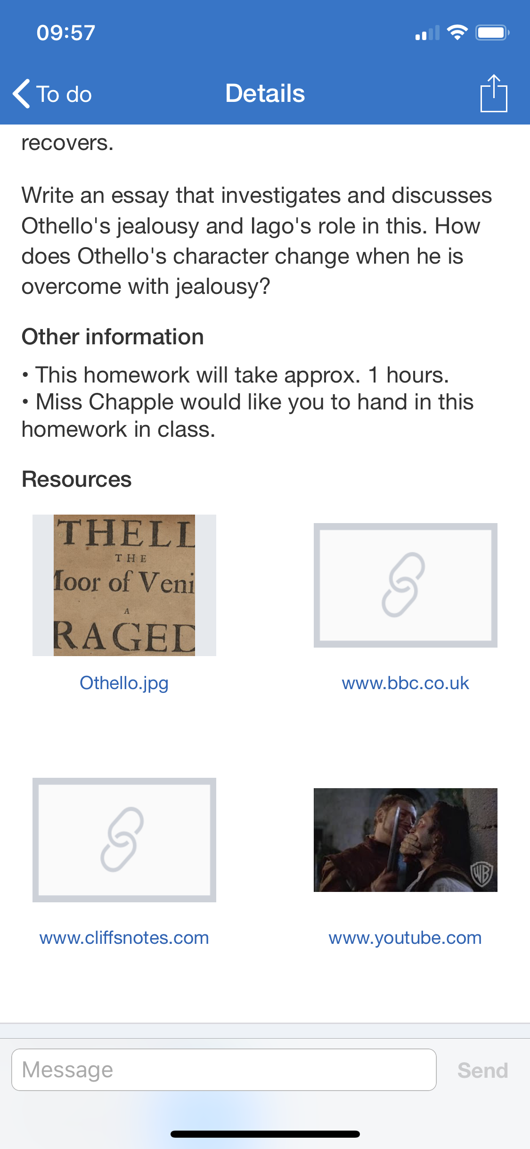
Click on a task for more details
All the info you need from teachers
Relevant links and resources attached
Support your child’s learning with confidence!

Slide 5
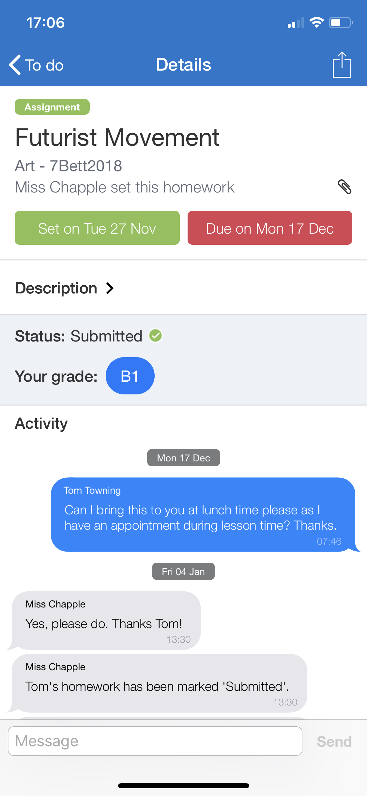
Does your child need more help?
They can send a message to their teacher
Keep up to date with the comments and advice your child receives
Notifications when teachers give homework a ‘submission status’
Teachers can mark homework so you can see their grades instantly!

Slide 6
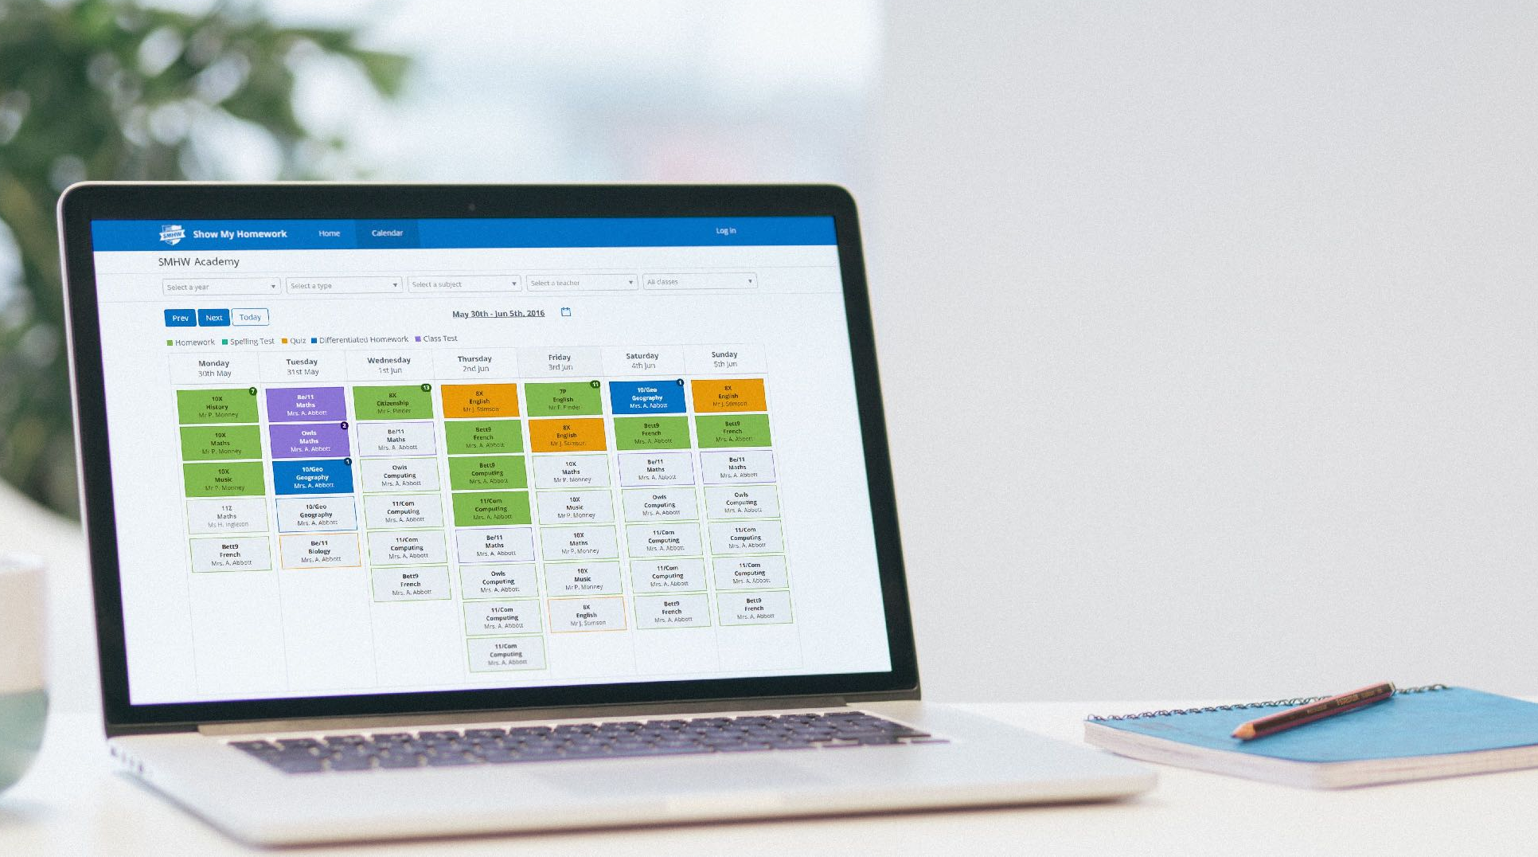
School Calendar
Can’t access your app?
Don’t worry - we have a back-up plan
Go to www.teamsatchel.com and search for your child’s school
See every piece of homework and use our filters to find what you need!

Slide 7
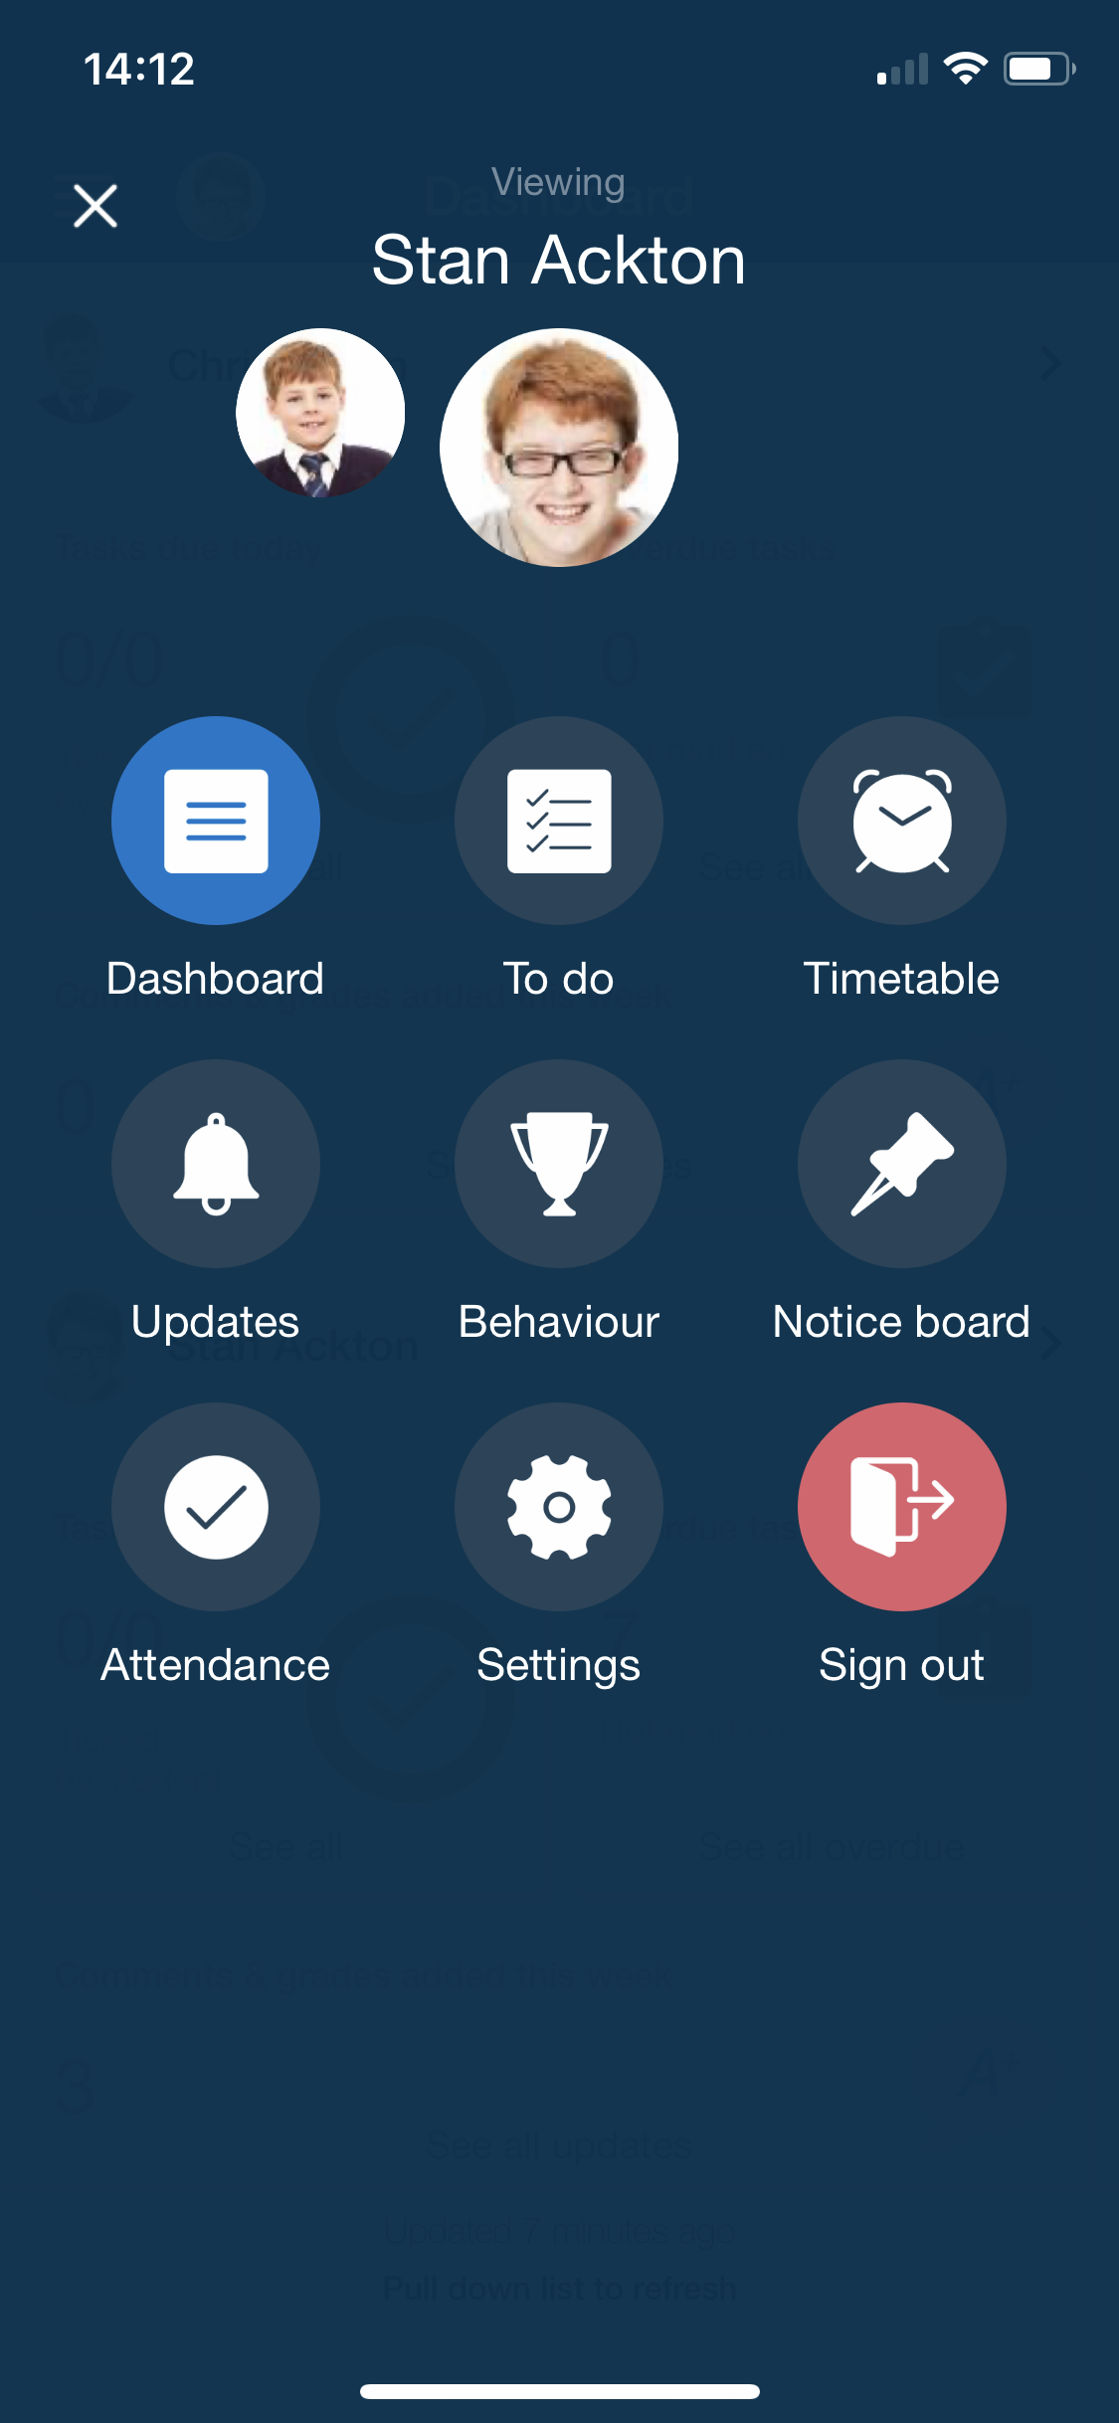
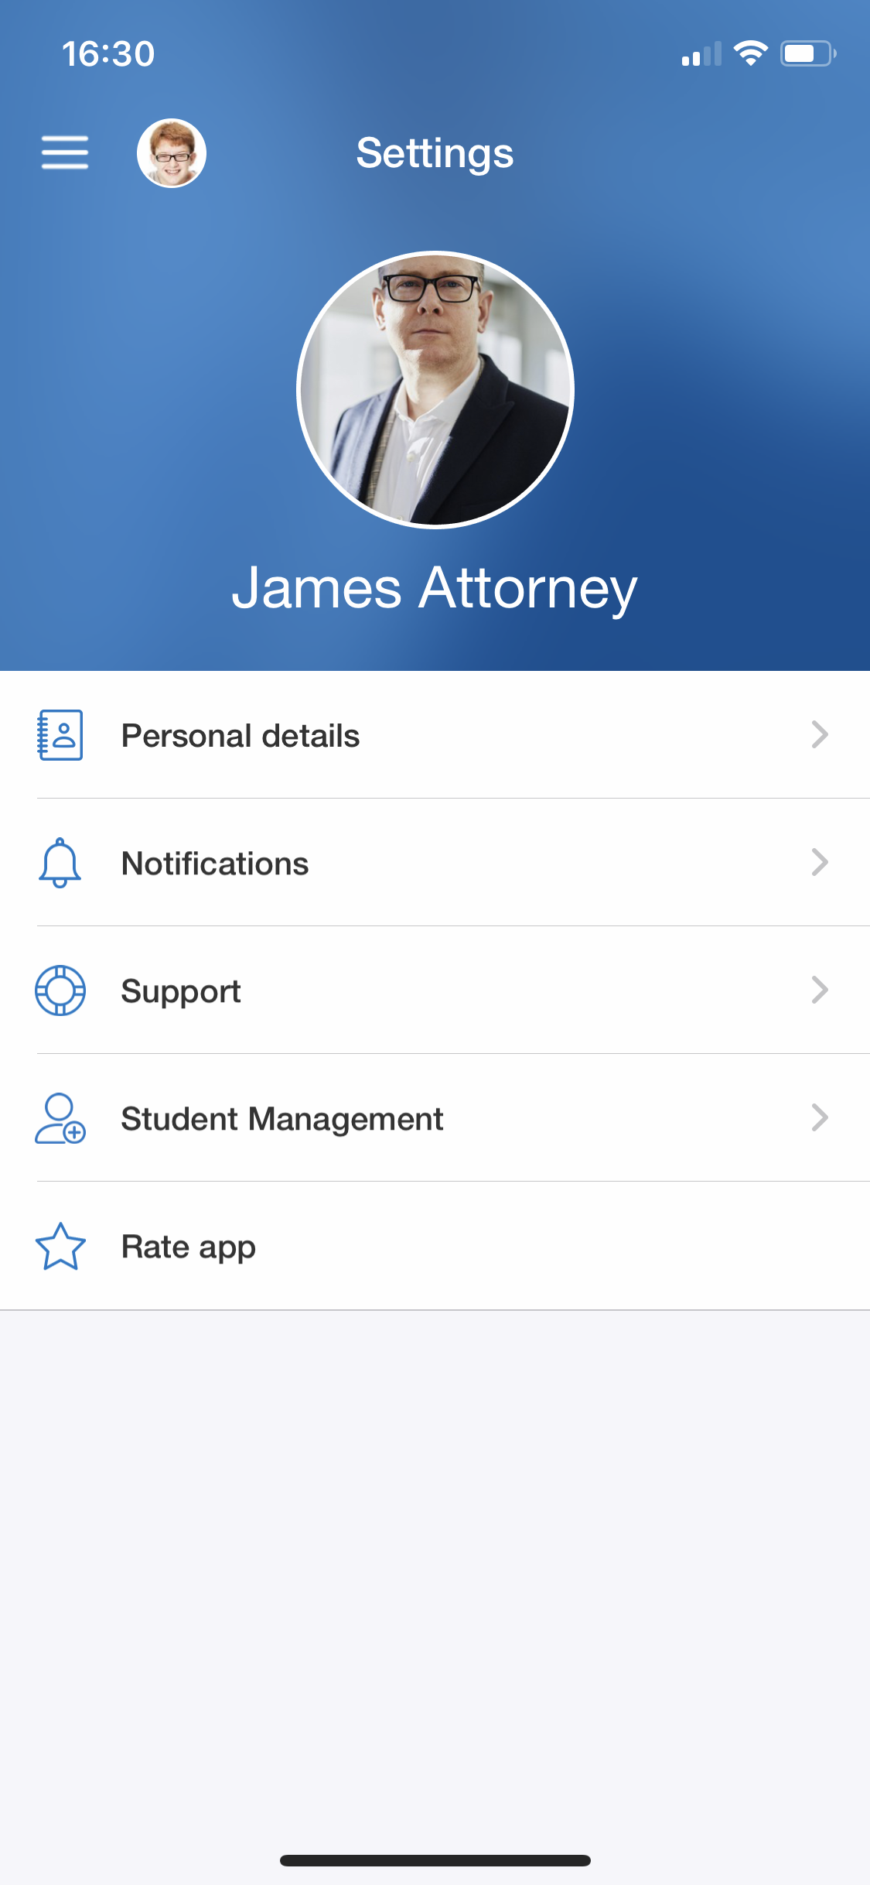
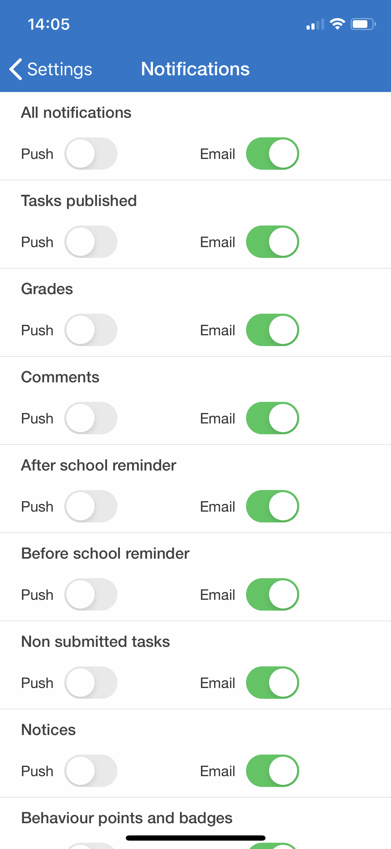
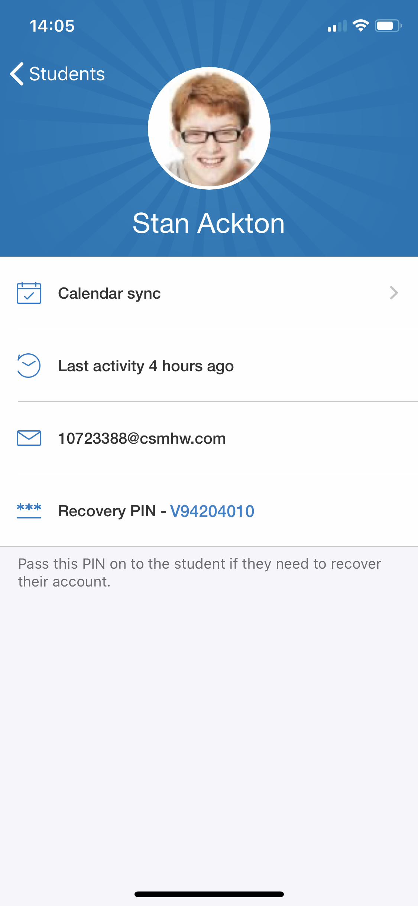
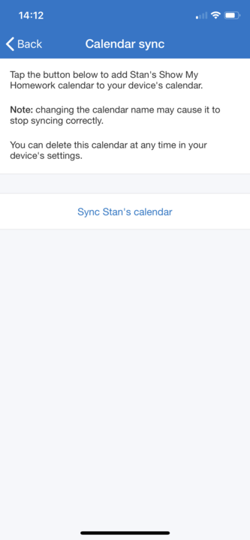
Settings
Notes:
Click ‘Settings’ on your menu to make changes to your details and preferences.
Personal details - Change your password here.
Notifications - Manage your notification options here and choose whether you’d like to receive push or email notifications for various features.
Support - Visit our Help Centre here or send us an email.
Student Management - Choose the child you’d like to manage and sync their calendar to your device, see their last activity, email address and recovery PIN in the event that they need to recover their account. Handy!
Rate app - Please share your feedback with us here.

Slide 8
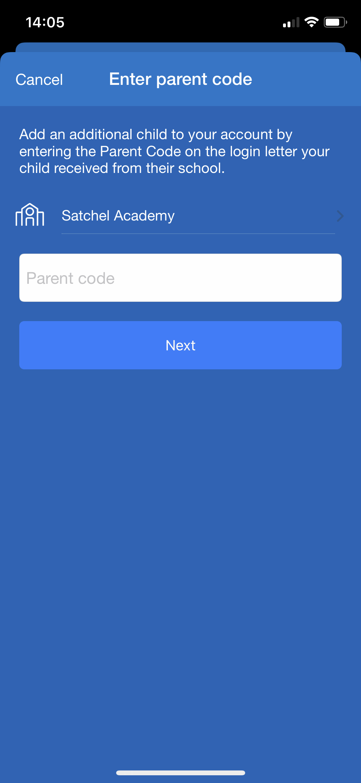
Settings - Add another student
Notes:
Add another student - If you would like to add another one of your children to your account, press the + button at the top right of your screen. Type in the school name that your child attends and the unique parent code that you have been given by the school.

Slide 9
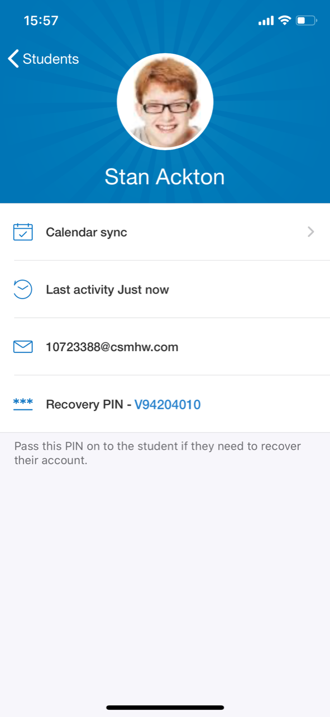
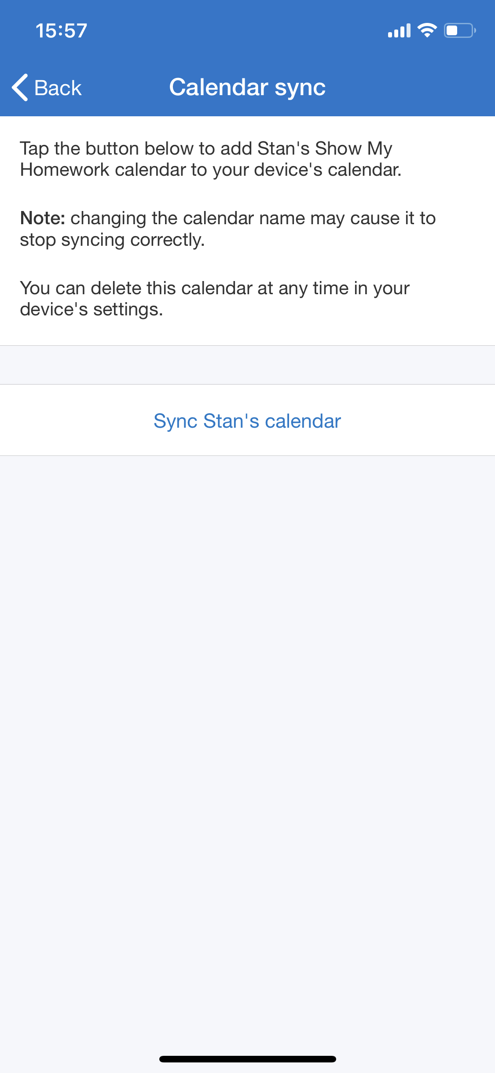
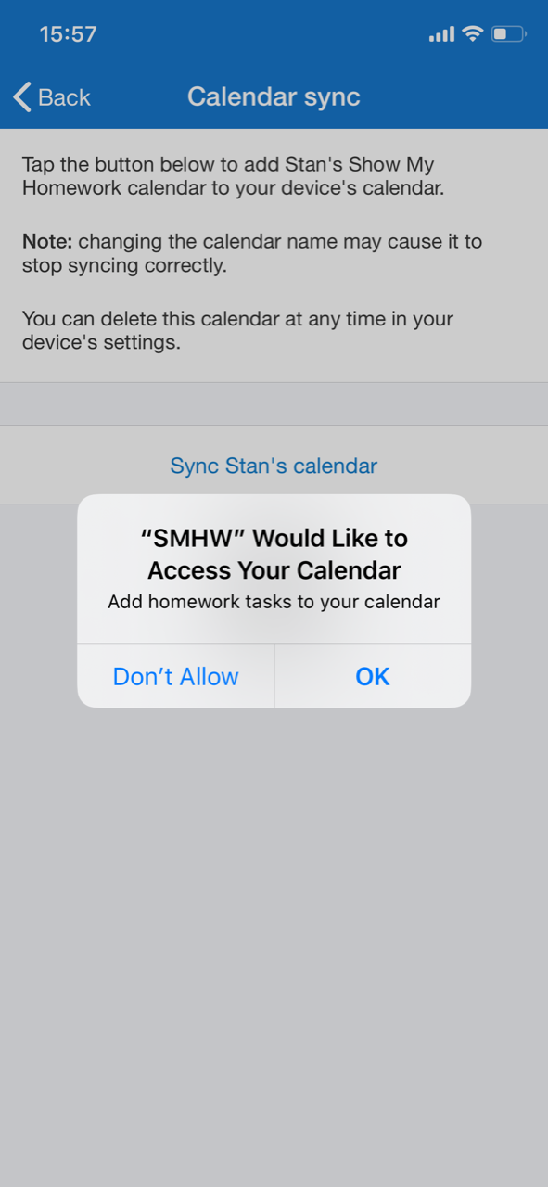
Settings - Sync with personal calendar
Notes:
Sync calendars - If you’d like to, you can synchronise your children’s homework calendars with your own so you can keep track of homework as well as your day to day life.
Go to ‘Settings’ and ‘Student management’. Click the student you’d like to add to your calendar and then click the ‘iCal calendar’ button.
You’ll then be prompted to ‘Sync ____’s calendar’. Tap this button and then allow SMHW to access your calendar. You can do this with each student and you can remove it from your personal calendar in your device’s settings if necessary.

Slide 10
Downloading the App
Please download the Show My Homework App to receive push notifications and manage homework on the go!
Notes:
Download our free app so that you can manage SMHW on the go!

Slide 11
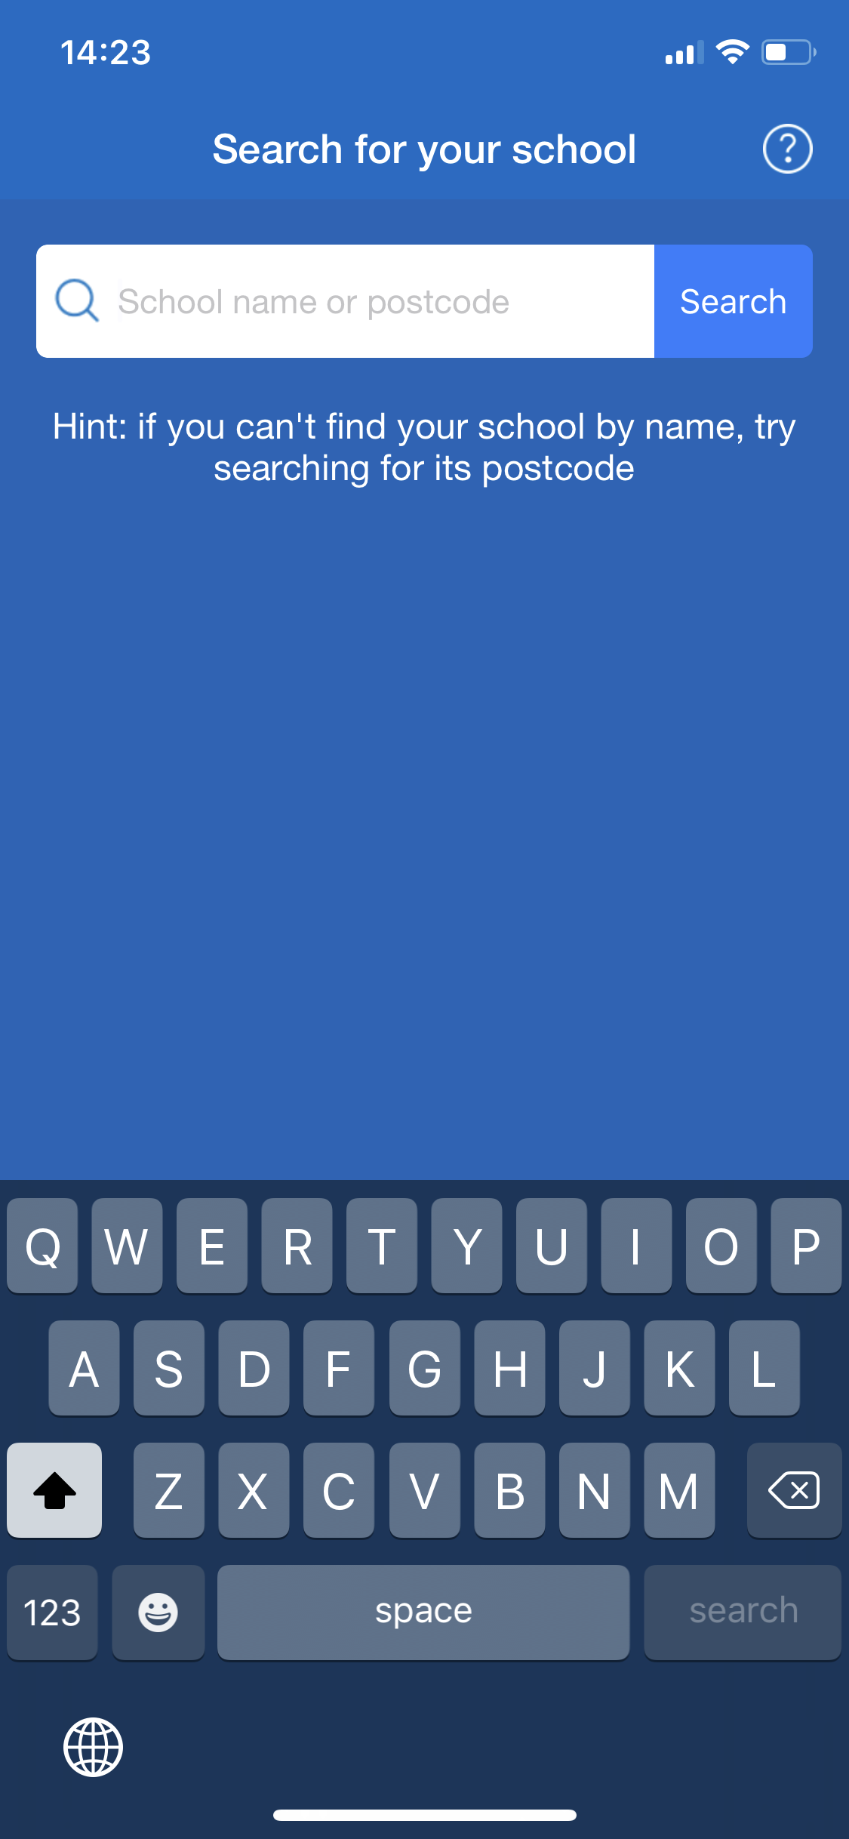
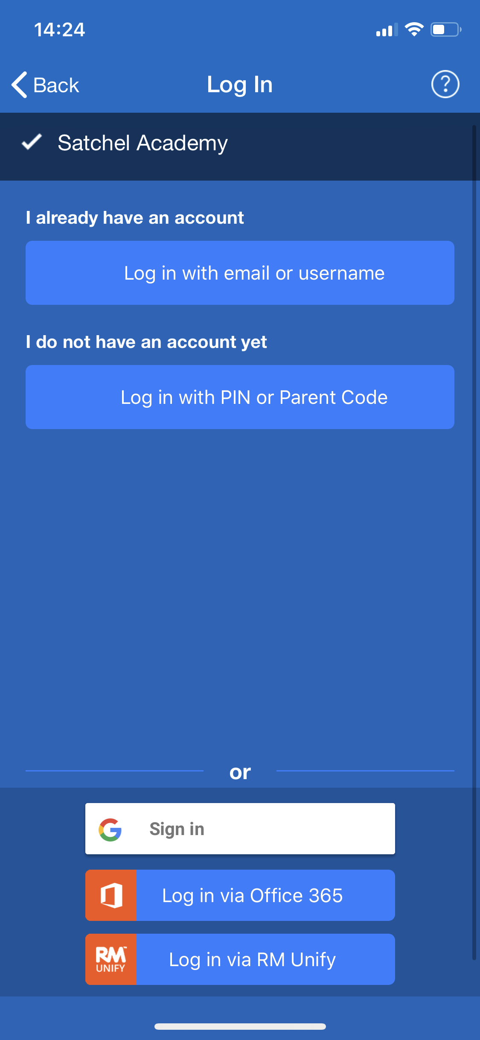
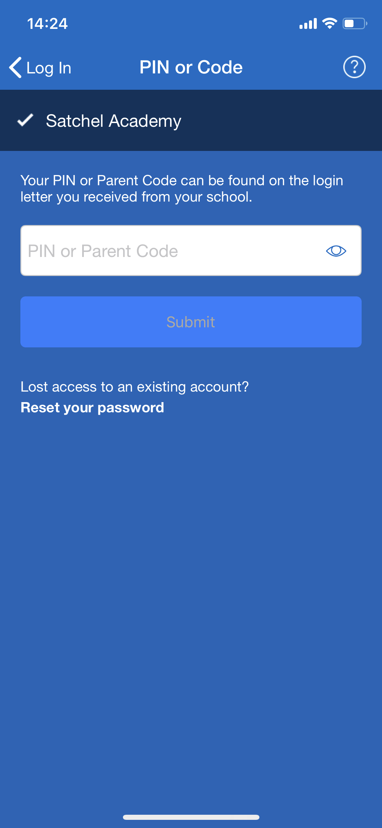
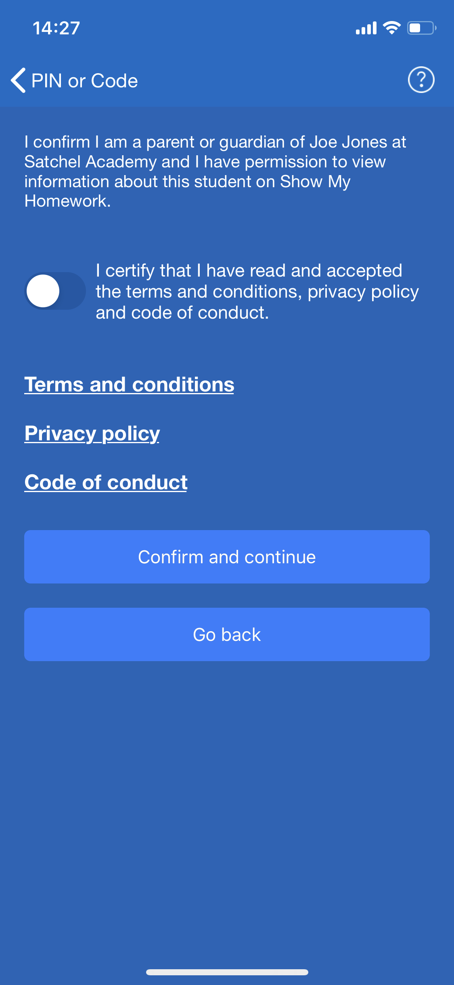
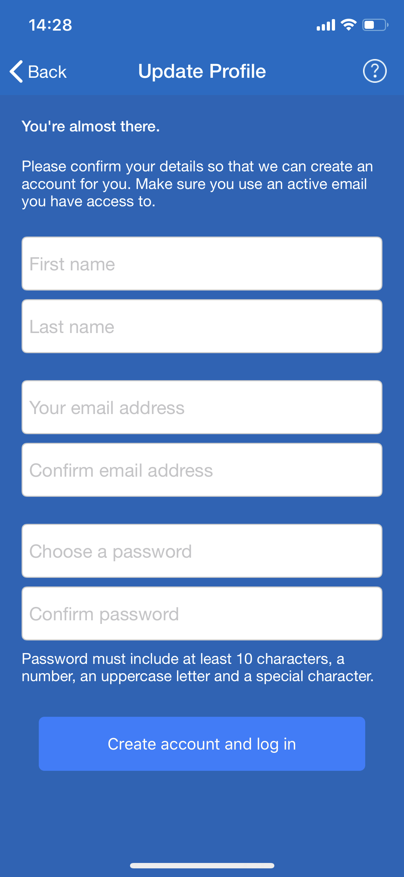
Getting Started - Parent Code
1
2
3
4
5
Open the app and search for your school
Choose ‘I do not have an account yet / Log in with PIN or Parent Code’
Type in the Parent Code that you received from school
Press the toggle to confirm that you are the parent / guardian of this child. Choose ‘Confirm and continue’
Fill out your personal details and choose a password.
Choose ‘Create account and log in’. Use your email address and new password for future logins!

Slide 12
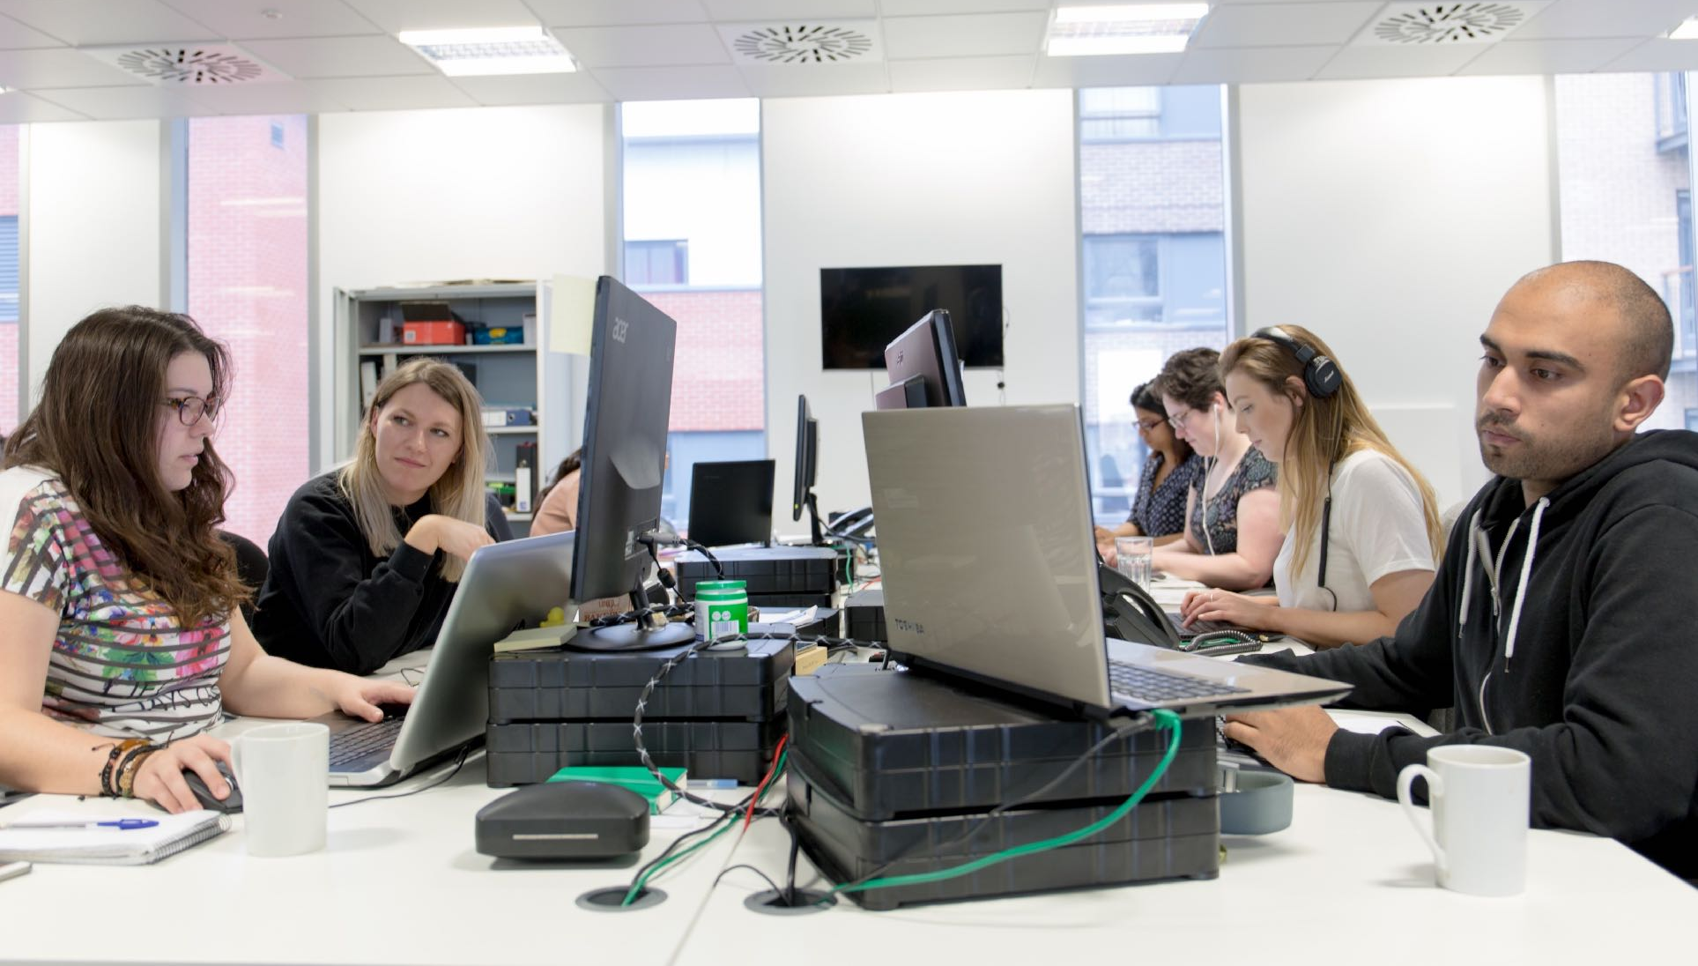
Support
Unlimited support for teachers, students and their parents from our highly skilled team of experts.
help@teamsatchel.com
020 7197 9550 (Option 2)

Slide 13
www.teamsatchel.com
020 7197 9550 (Option 2)
help@teamsatchel.com
@team_satchel

