Slide 1
A Student’s Guide to
Show My Homework
Part of Satchel One

Slide 2
How Show My Homework can help...
Keep your homework organised
See how much homework you have
Get reminders for when homework is due
Keep up to date when you’re away from school
Message your teacher in private if you need help with your work
Remove the need to write your homework down before leaving class

Slide 3
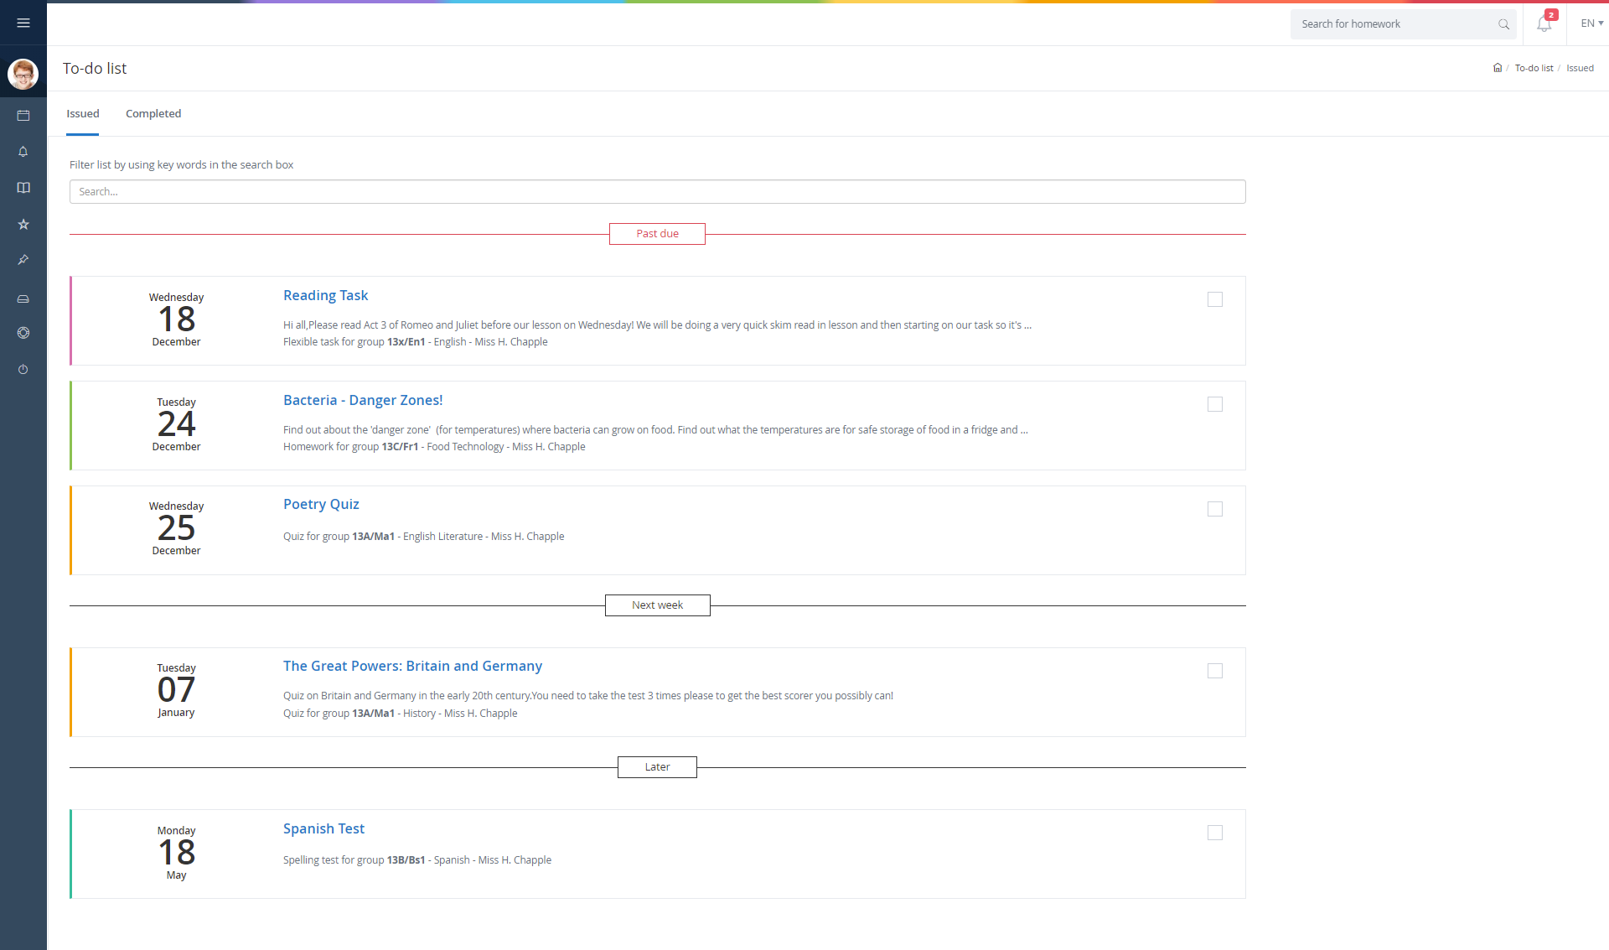
Download our free app or use on a desktop
Keep on top of your to-do list
Your work is organised by due date
Stay updated when you’re away from school
Tick off your work when it’s done - so simple!

Slide 4
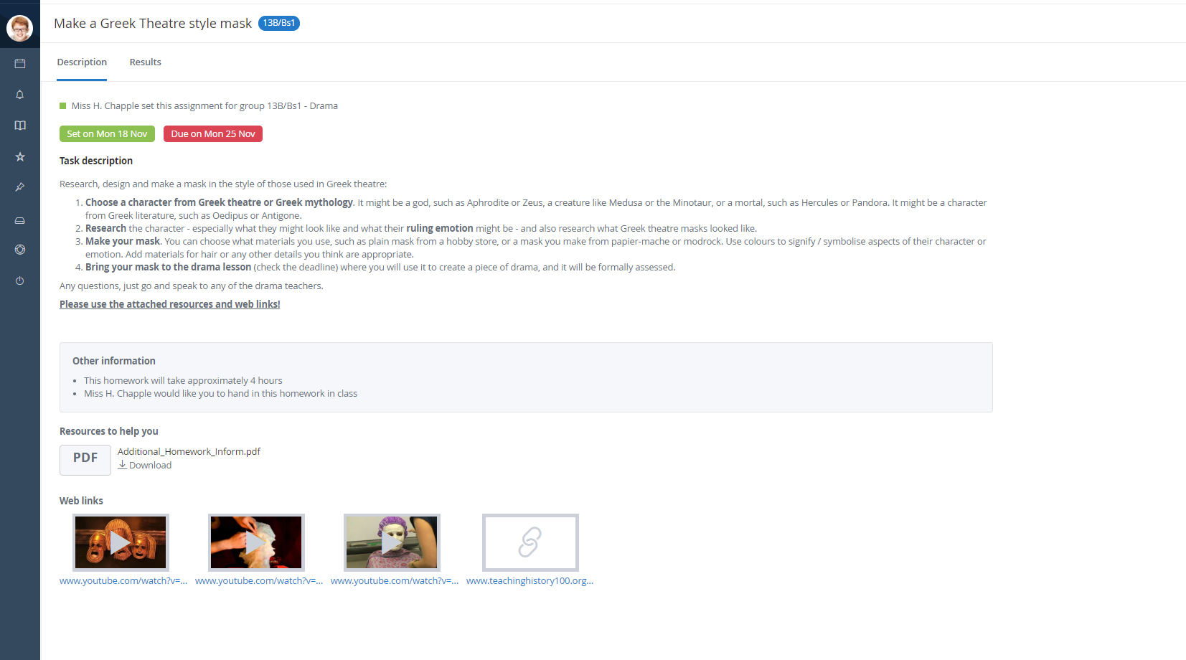
Click on a task for more details
All the info you need from your teachers
Links and resources attached to help you
No more scribbling down homework notes!

Slide 5
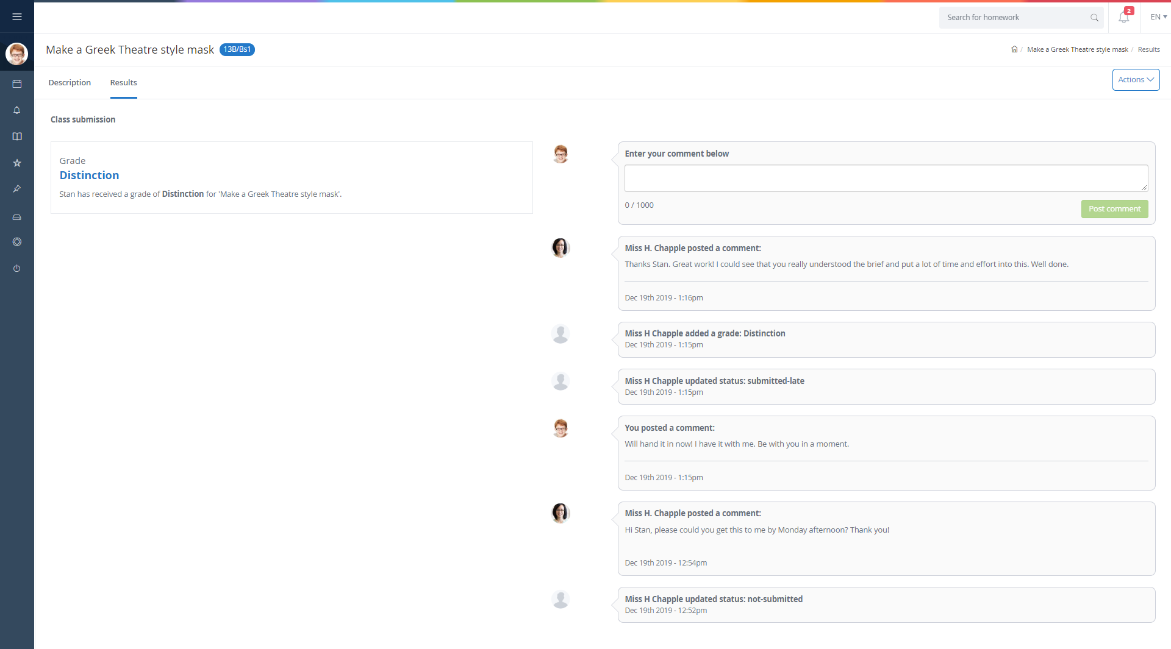
Need more help?
Send a message to your teacher
They can give support online or at school
Submit work online or in class; your teacher can decide
Upload documents, photos or share a written, essay style response
Teachers can mark your homework so you can see your grade instantly!

Slide 6
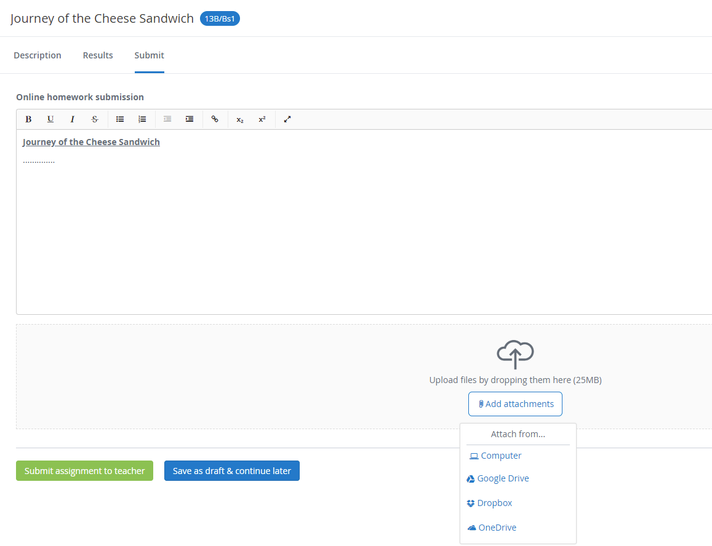
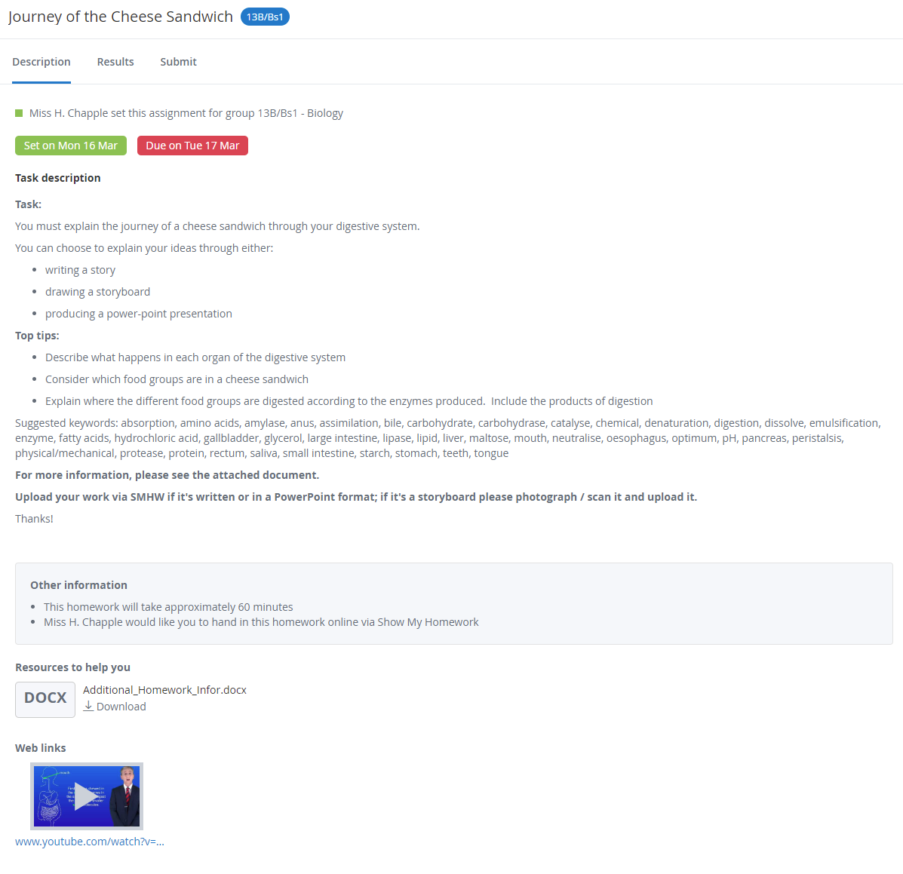
Submitting work online via the website
Notes:
Click the ‘Submit’ tab.
This will allow you to type a written response using our inbuilt word processor. You can then share your answer by clicking the green ‘Submit assignment to teacher’ button!
Alternatively, you can choose to ‘Add attachments’ and share a document or photo of your work.
When you’ve submitted your work, you can choose to click ‘Submit’ again and share additional work or supporting documents.
If you’d like, save your work as a draft and come back to it later; next time you click ‘Submit’ on this task you will be able to pick up where you left off.

Slide 7
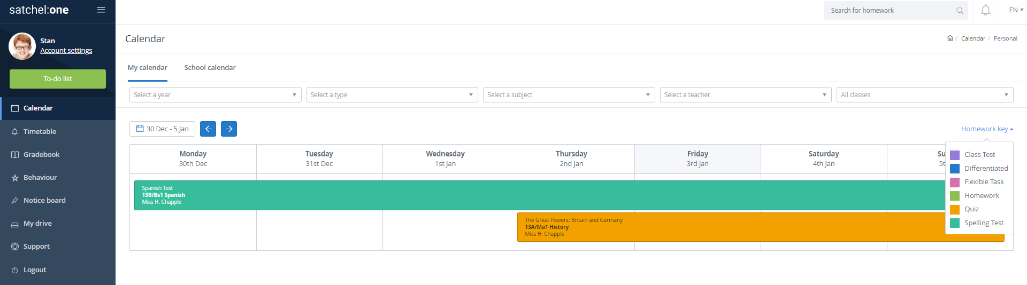
Calendar
View your homework in a more visual way via your calendar
Colour coded tasks stretch across the timespan, allowing you to see your workload
Use the filters as needed and click ‘School calendar’ to see all homework across the school!

Slide 8
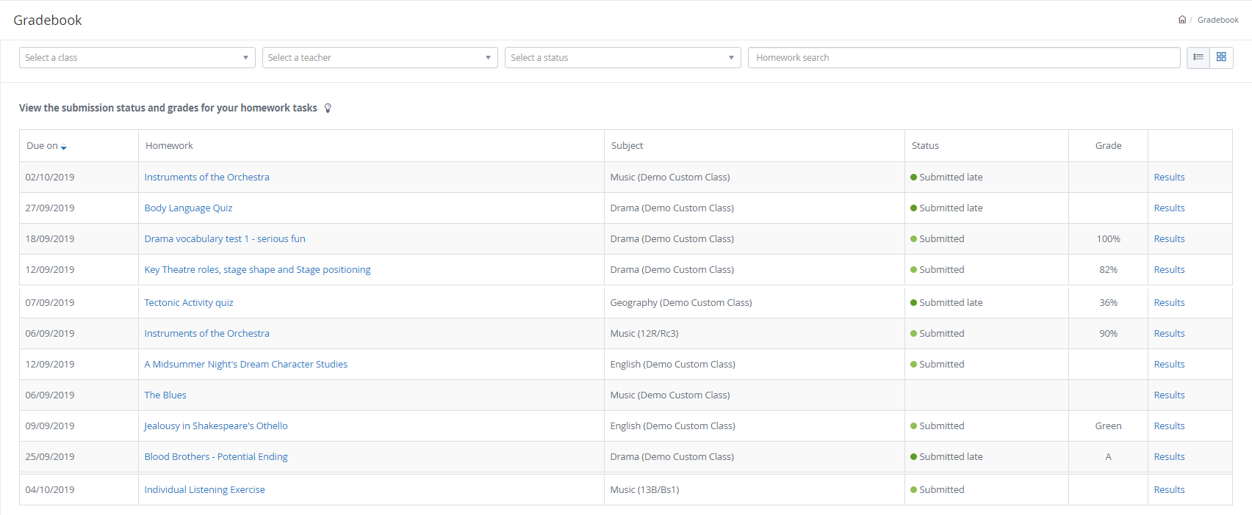
The Gradebook
See all homework, submission stats, grades and comments in one place

Slide 9
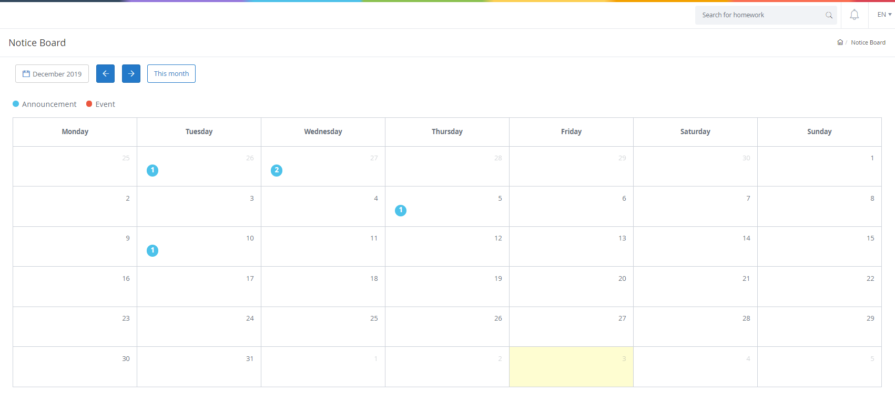
Notice board
Keep track of school announcements and events via the notice board

Slide 10
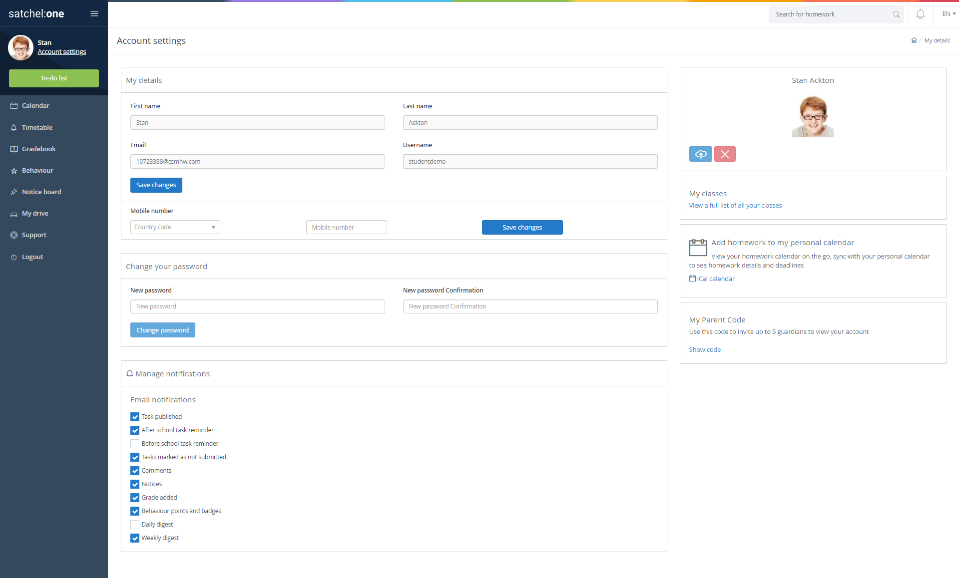
Manage your account settings
Change notification settings and passwords
Sync your homework to your calendar and access your parent code

Slide 11
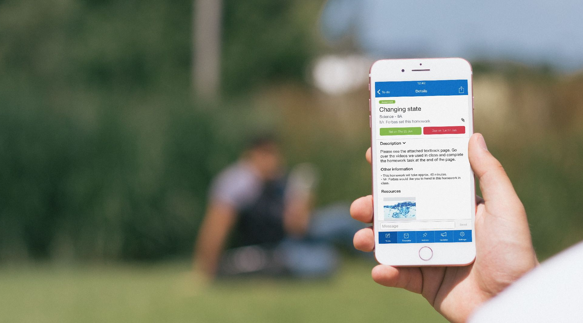
Parent / Guardian Access
Parents / guardians can use the website and app too
They can view your to-do list and task info any time
Allows parents / guardians to offer support and guidance
Demonstrate your independent study skills - they will love it!

Slide 12
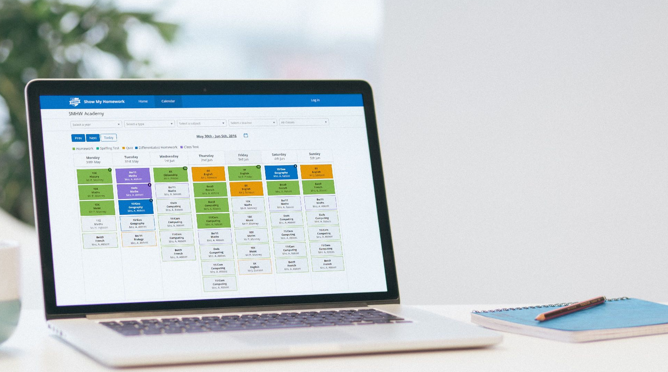
School Calendar
Can’t access your account?
Don’t worry - we have a back-up plan
Go to www.teamsatchel.com and search for your school
See every piece of homework and use our filters to find what you need!

Slide 13
Getting Started - PIN
1
2
3
Click the ‘Student’ tab and then choose ‘I don’t have an account yet’.
Enter your school, email address and the PIN that was given to you by your school (not the Parent Code).
Tick the Captcha box and click ‘Sign up’.
Confirm the below details and then choose your password.
Confirm your password and click ‘Log in’.
You will now be able to login with your email and chosen password from the ‘Student’ tab by choosing ‘I already have an account’.

Slide 14
Getting Started - Single Sign On
Click the ‘Student’ tab and then choose ‘I already have an account’.
Choose the appropriate SSO option for your school and fill in your details accordingly to access your account.

Slide 15
Downloading the App
Please download the Show My Homework App to receive push notifications and manage your homework on the go!

Slide 16
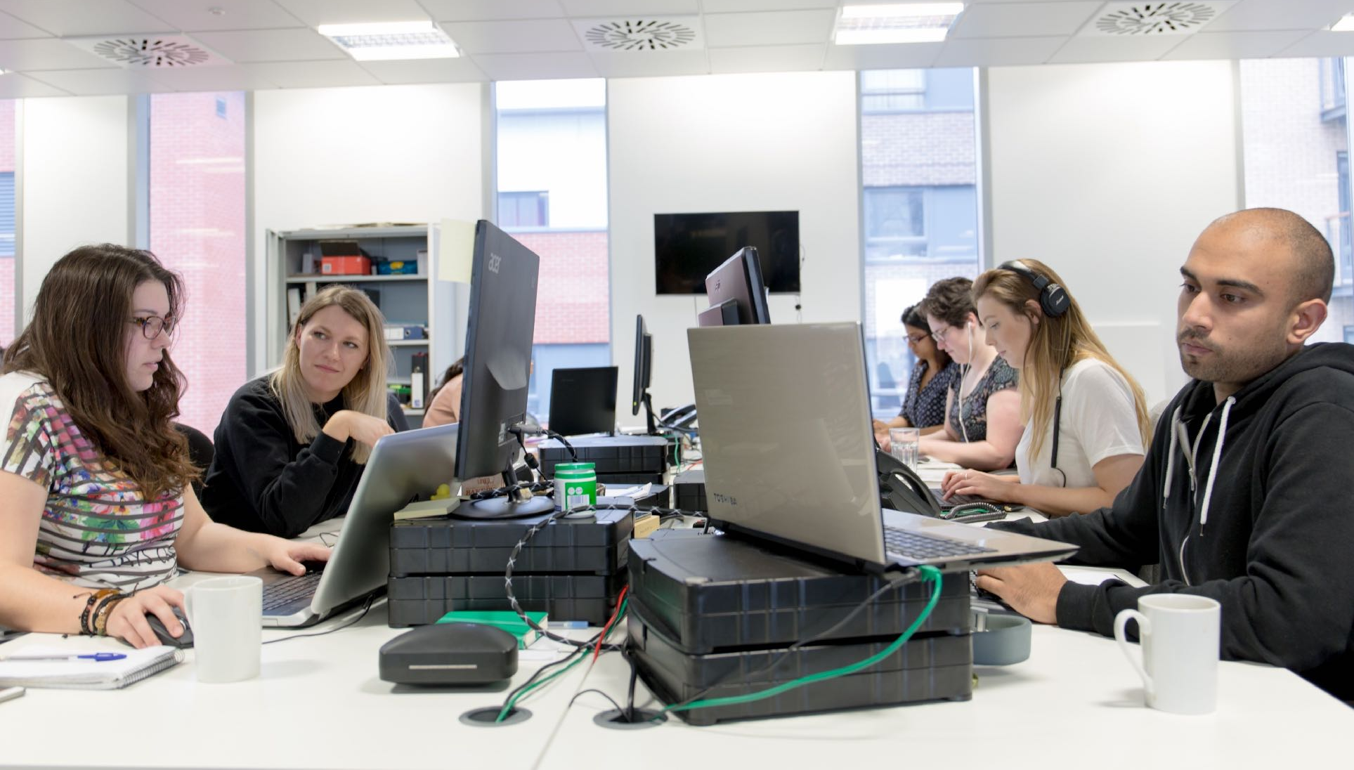
Support
Unlimited support for teachers, students and their parents from our highly skilled team of experts.
help@teamsatchel.com
020 7197 9550 (Option 2)

Slide 17
www.teamsatchel.com
0207 197 9550 (Option 2)
help@teamsatchel.com
@team_satchel

